Slide 1

Telco Customer Churn Analysis
Insights for effective decision-making
Presented by: Pharaoh CHIRCHIR
23 Sep 2024

Slide 2
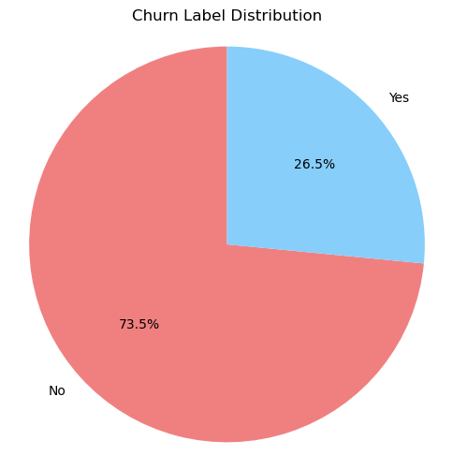

Introduction
Customer churn is a critical issue in the telecommunications industry, affecting profitability and growth.
Understanding churn patterns helps businesses enhance customer retention strategies and improve overall service quality.
The visual demonstrates 26.5 % of customers leave the industry for other firms and there is need to address the issue at hand.

Slide 3
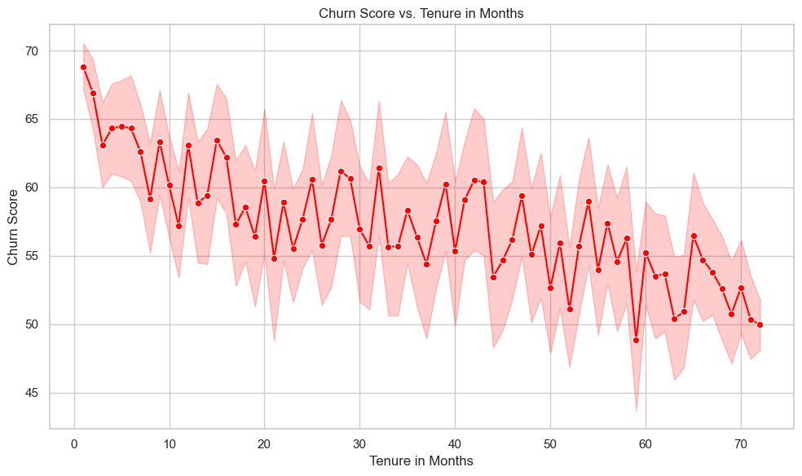
Business Problem
High Churn Rates: The average churn rate in the telecom sector is around 1.9% per month, leading to significant revenue loss.
Retention vs. Acquisition: Retaining existing customers is often more cost-effective than acquiring new ones.
Impact on Revenue: Each lost customer can cost the company thousands of dollars in potential revenue over their lifetime.
Visual: Line graph illustrating historical churn rates and projected financial losses.

Slide 4
Objectives of the Analysis
Identify Churn Drivers:
Determine key factors contributing to customer churn.
Develop Predictive Models:
Create models to predict future churn based on customer behavior.
Recommend Strategic Actions:
Provide actionable insights for improving customer retention.

Slide 5
Data Overview
Dataset Characteristics:
7,043 customer records
Features:
Includes demographic information, account details, service usage, and churn labels.
Data Sources:
Customer surveys, service usage logs, and transaction records.

Slide 6

Methodology
Step 1
Data Preprocessing:
Data cleaning, handling missing values, and feature selection.
Step 2
Exploratory Data Analysis (EDA):
Visualizations to understand customer behavior and identify churn patterns.
Step 3
Model Development:
Utilized Logistic Regression and Random Forest classifiers to predict churn.
Step 4
Model Deployment
Model Training & Validation
Feedback loop
Post-Deployment Maintenance
Monitoring and Logging

Slide 7
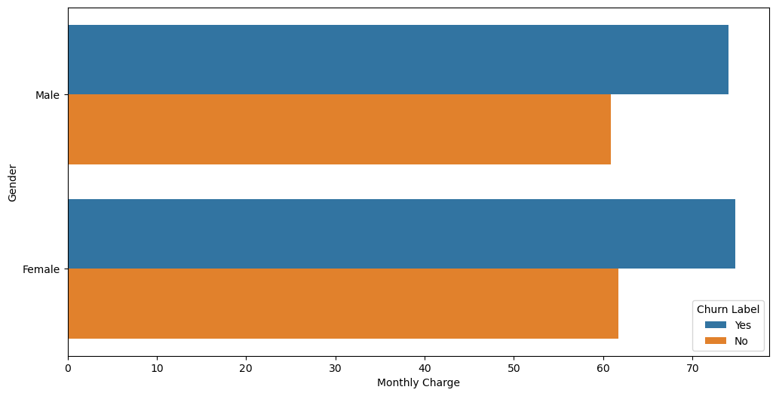
Key Findings
Churn Influencers: Key factors include:
Customer tenure
Monthly charges
Payment method
Customer service interactions
Customer Segments:
High churn rates observed among younger demographics and those with high monthly charges.

Slide 8
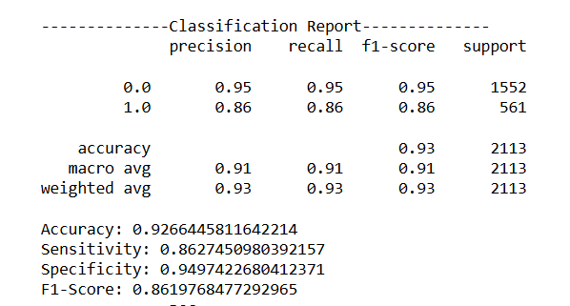
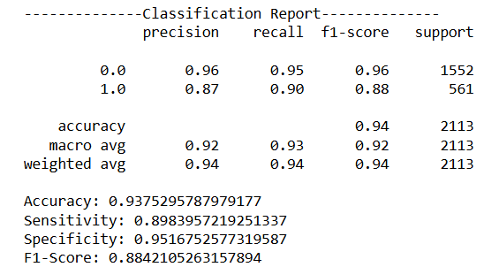
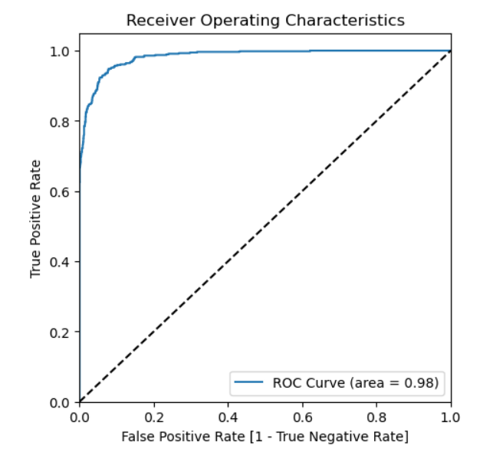
Predictive Model Results
Logistic Regression Model Results
Random Forest Model Results
Model Performance:
Logistic Regression: Accuracy = 92.6%, Precision = 95%, Recall = 95%.
Random Forest: Accuracy = 93.7%, Precision = 96%, Recall = 95%
ROC Curve: Random Forest model demonstrated a robust ability to discriminate between churners and non-churners.
Random Forest ROC Curve

Slide 9
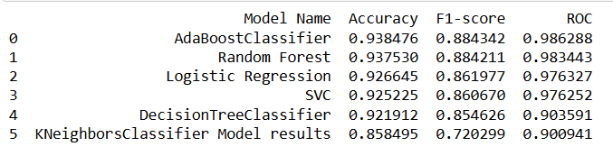
Evaluating the performance of different models
Best Performing Models: - AdaBoostClassifier and Random Forest both show the highest performance across all metrics, with the highest accuracy, F1-score, and ROC AUC.
Good Performers: - Logistic Regression and SVC also show strong performance, though slightly less so compared to AdaBoost and Random Forest.
Weaker Models: - Decision Tree and KNeighborsClassifier have lower scores, particularly in the ROC AUC and F1-score, indicating they may not perform as well in distinguishing and balancing between classes.

Slide 10
Business Value
Informed Decision-Making:
Insights from churn analysis empower stakeholders to develop targeted retention strategies.
Cost Reduction:
Improved retention efforts can significantly reduce customer acquisition costs, increasing profitability.
Customer Satisfaction:
Enhanced understanding of customer needs can lead to improved service offerings and customer loyalty.

Slide 11
Recommendations
Targeted Retention Campaigns:
Focus on high-risk segments identified through analysis.
Improved Customer Support:
Enhance customer service responsiveness to address issues before they lead to churn.
Flexible Pricing Plans:
Introduce tailored pricing options based on customer usage patterns.

Slide 12
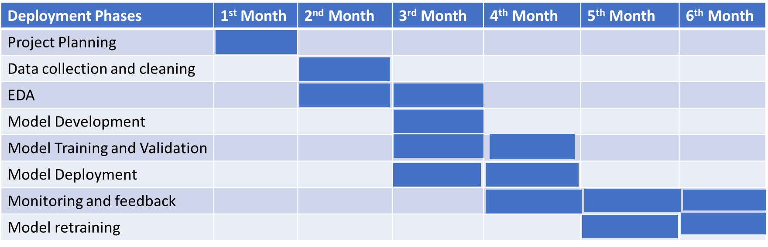
Implementation Strategy
Timeline: 6-month implementation plan
Responsibilities: Assign roles to marketing, customer service, and data analytics teams.
Monitoring & Evaluation: Set KPIs to measure the success of implemented strategies.

Slide 13
Expected Outcomes
Projected Churn Reduction: Anticipated decrease in churn rates by 15% within the first year of implementing strategies.
Increased Customer Retention: Long-term customer loyalty and enhanced brand reputation.
Visual: Line graph illustrating projected churn rates over the next few years.

Slide 14
Conclusion
Predictive modeling and analytics, emphasizing the importance of proactive measures to address customer churn.
Data analytics has a significant business impact when driving business decisions.
There is a need for predictive modeling to implement control mechanisms for customer churn rates.

Slide 15


Q&A

